Slide 1

Cover
not found.

Slide 2
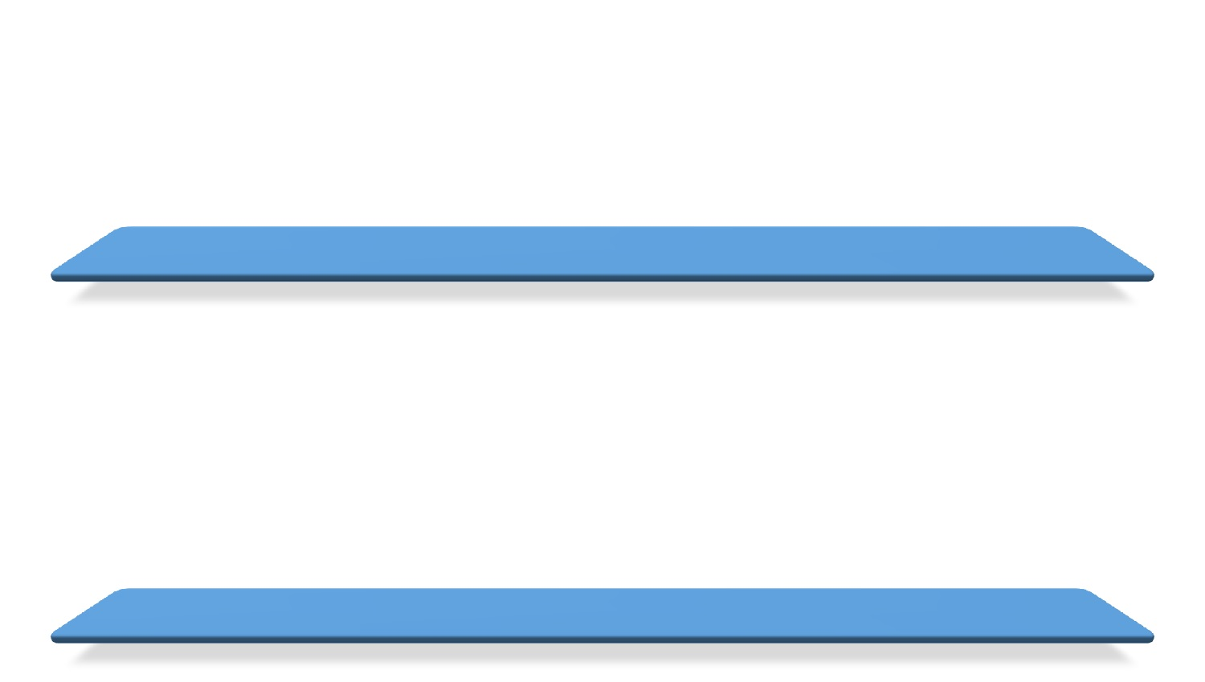

Slide 4


Slide 5


Slide 6
